Slide 1
Azure Monitoring Hackathon
Azure Monitor

Slide 2
Agenda
10:00 – 10:30: Kickoff
10:30 – 11:30: Azure Security & Management overview
11:30 – 12:15: Lunch
12:15 – 14:00: Azure Monitor and Alert Rule challenges
14:00 – 14:15: Break
14:15 – 16:15: Log Analytics challenges (this is the cool stuff especially for security folks!)
16:15 – 16:30: Break
16:30 – 17:00: Team sync: The good, the bad, and the ugly

Slide 3
Monitoring Hackathon Setup
Deploy Infra using PowerShell \ CLI and an ARM Template
Setup Azure Module on Windows PowerShell https://docs.microsoft.com/en-us/powershell/azure/install-azurerm-ps?view=azurermps-6.9.0
Setup Azure CLI https://docs.microsoft.com/en-us/cli/azure/install-azure-cli?view=azure-cli-latest
Install Visual Studio Code and Extensions (depending on your tool of choice)
Azure Resource Manager Tools - https://marketplace.visualstudio.com/items?itemName=msazurermtools.azurerm-vscode-tools
ARM snippets - https://marketplace.visualstudio.com/items?itemName=artofshell.armsnippet
PowerShell - https://marketplace.visualstudio.com/items?itemName=ms-vscode.PowerShell
Azure CLI Tools – https://marketplace.visualstudio.com/items?itemName=ms-vscode.azurecli
Download Azure Monitoring Hackathon as a zip file and extract it to a folder - https://github.com/peterschen/AzureMonitoringHackathon
From the Student/Resources folder, open the DeployMonHackEnv.(ps1 or sh) and azuredeploy.parameters.json files and follow the instructions.

Slide 4
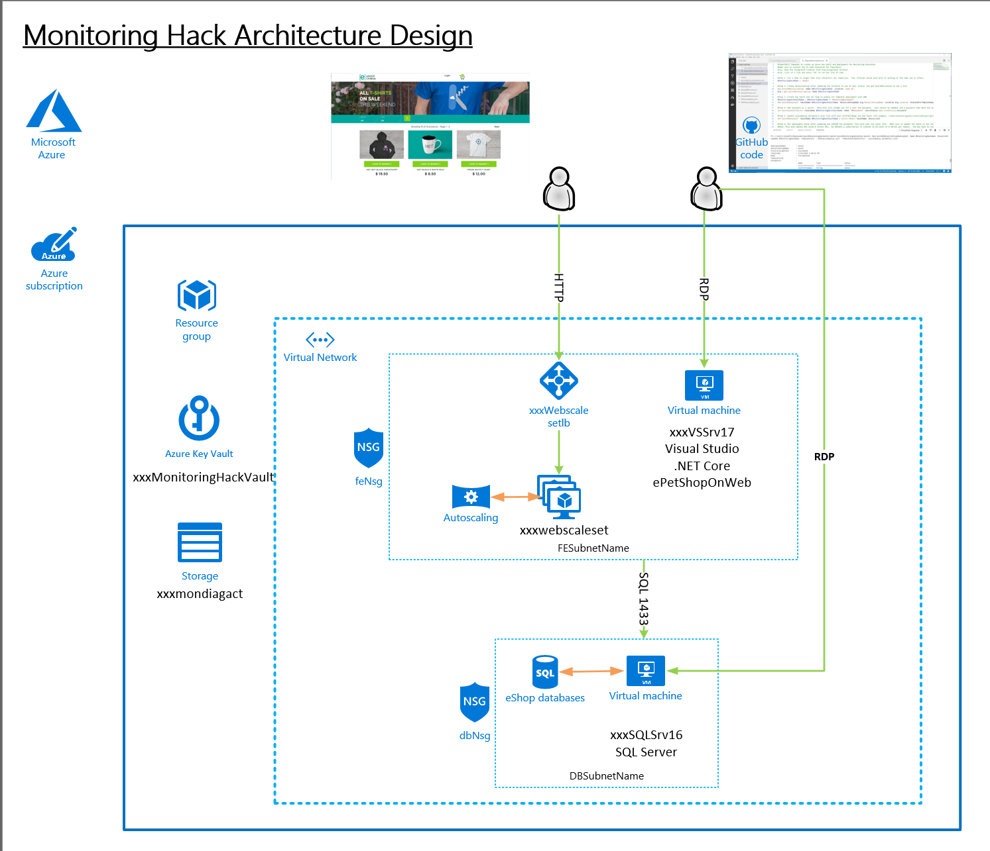
Should look like this ☺

Slide 5
Monitoring and Alert Rule Challenge
Prep
Turn off IE Enhanced Security Configuration in Server Manager
Download and Install HammerDB tool on the Visual Studio VM: www.hammerdb.com
Create a database called “tpcc” on the SQL Server
Use HammerDB Build to create transaction load
From Azure Portal, enable guest-level monitoring on SQL Server
Add a Performance Counter Metric for
Object: SQLServer:Databases
Counter: Active Transactions
Instance:tpcc
From Azure Monitor, create a graph for SQL Server Active Transactions and Percent CPU and pin to your Azure Dashboard
Configure the new Azure Monitor sink for guest-level monitoring and alerting
Create an Alert if Active Transactions goes over 100 on the SQL Server tpcc database and configure the action group to send an email to yourself when the threshold is exceeded
Create an Alert Rule for CPU over 75% on the Virtual Scale Set that emails yourself when you go over the threshold.
First team to send me both alerts wins the challenge. Good luck!

Slide 6
Log Analytics Challenges
Create a new Log Analytics Workspace
From the portal connect SQL Server to your workspace.
Extra credits: Modify the ARM template to automatically connect your VM Scale Set to the workspace. Then redeploy template and verify the Web and SQL servers are connected
Connect the Azure Activity Log, NSG, LB, Key Vault and Storage Account
Add the following solutions: Activity Log Analytics, Key Vault, Agent Health, Alert Management
Add the standard performance counters, Application and System Event logs and IIS logs.
Deploy Service Map agents to Web Scale Set VMs and SQL Servers
Create a FE and BE group in Service Map
Generate DB load using HammerDB from the Visual Studio Server and view the results in Service Map
First Team to email me a screenshot with the Visual Studio Server detected by your Scale Set and detected by Service Map wins the challenge. Good luck!

Slide 7
Log Analytics Dashboard Challenge
Write Custom Performance queries for Web and SQL Servers and save to favorites
Processor Utilization: Processor / % Processor Time
Memory Utilization: Memory / % Committed Bytes In Use
Disk Utilization (IO): Disk Reads/sec and Disk Writes/sec
Render the queries in a timechart for the last 4 hours and save to favorites
Create a heartbeat query for Web and SQL Server
Create a Log Analytics Solution
Use your heartbeat query for the Overview tile
Use your performance queries to create a line chart & list for Processor, Memory and Disk (Reads & Writes).
First Team to email me a screenshot with your Solution wins the challenge. Good luck!

